Slide 1
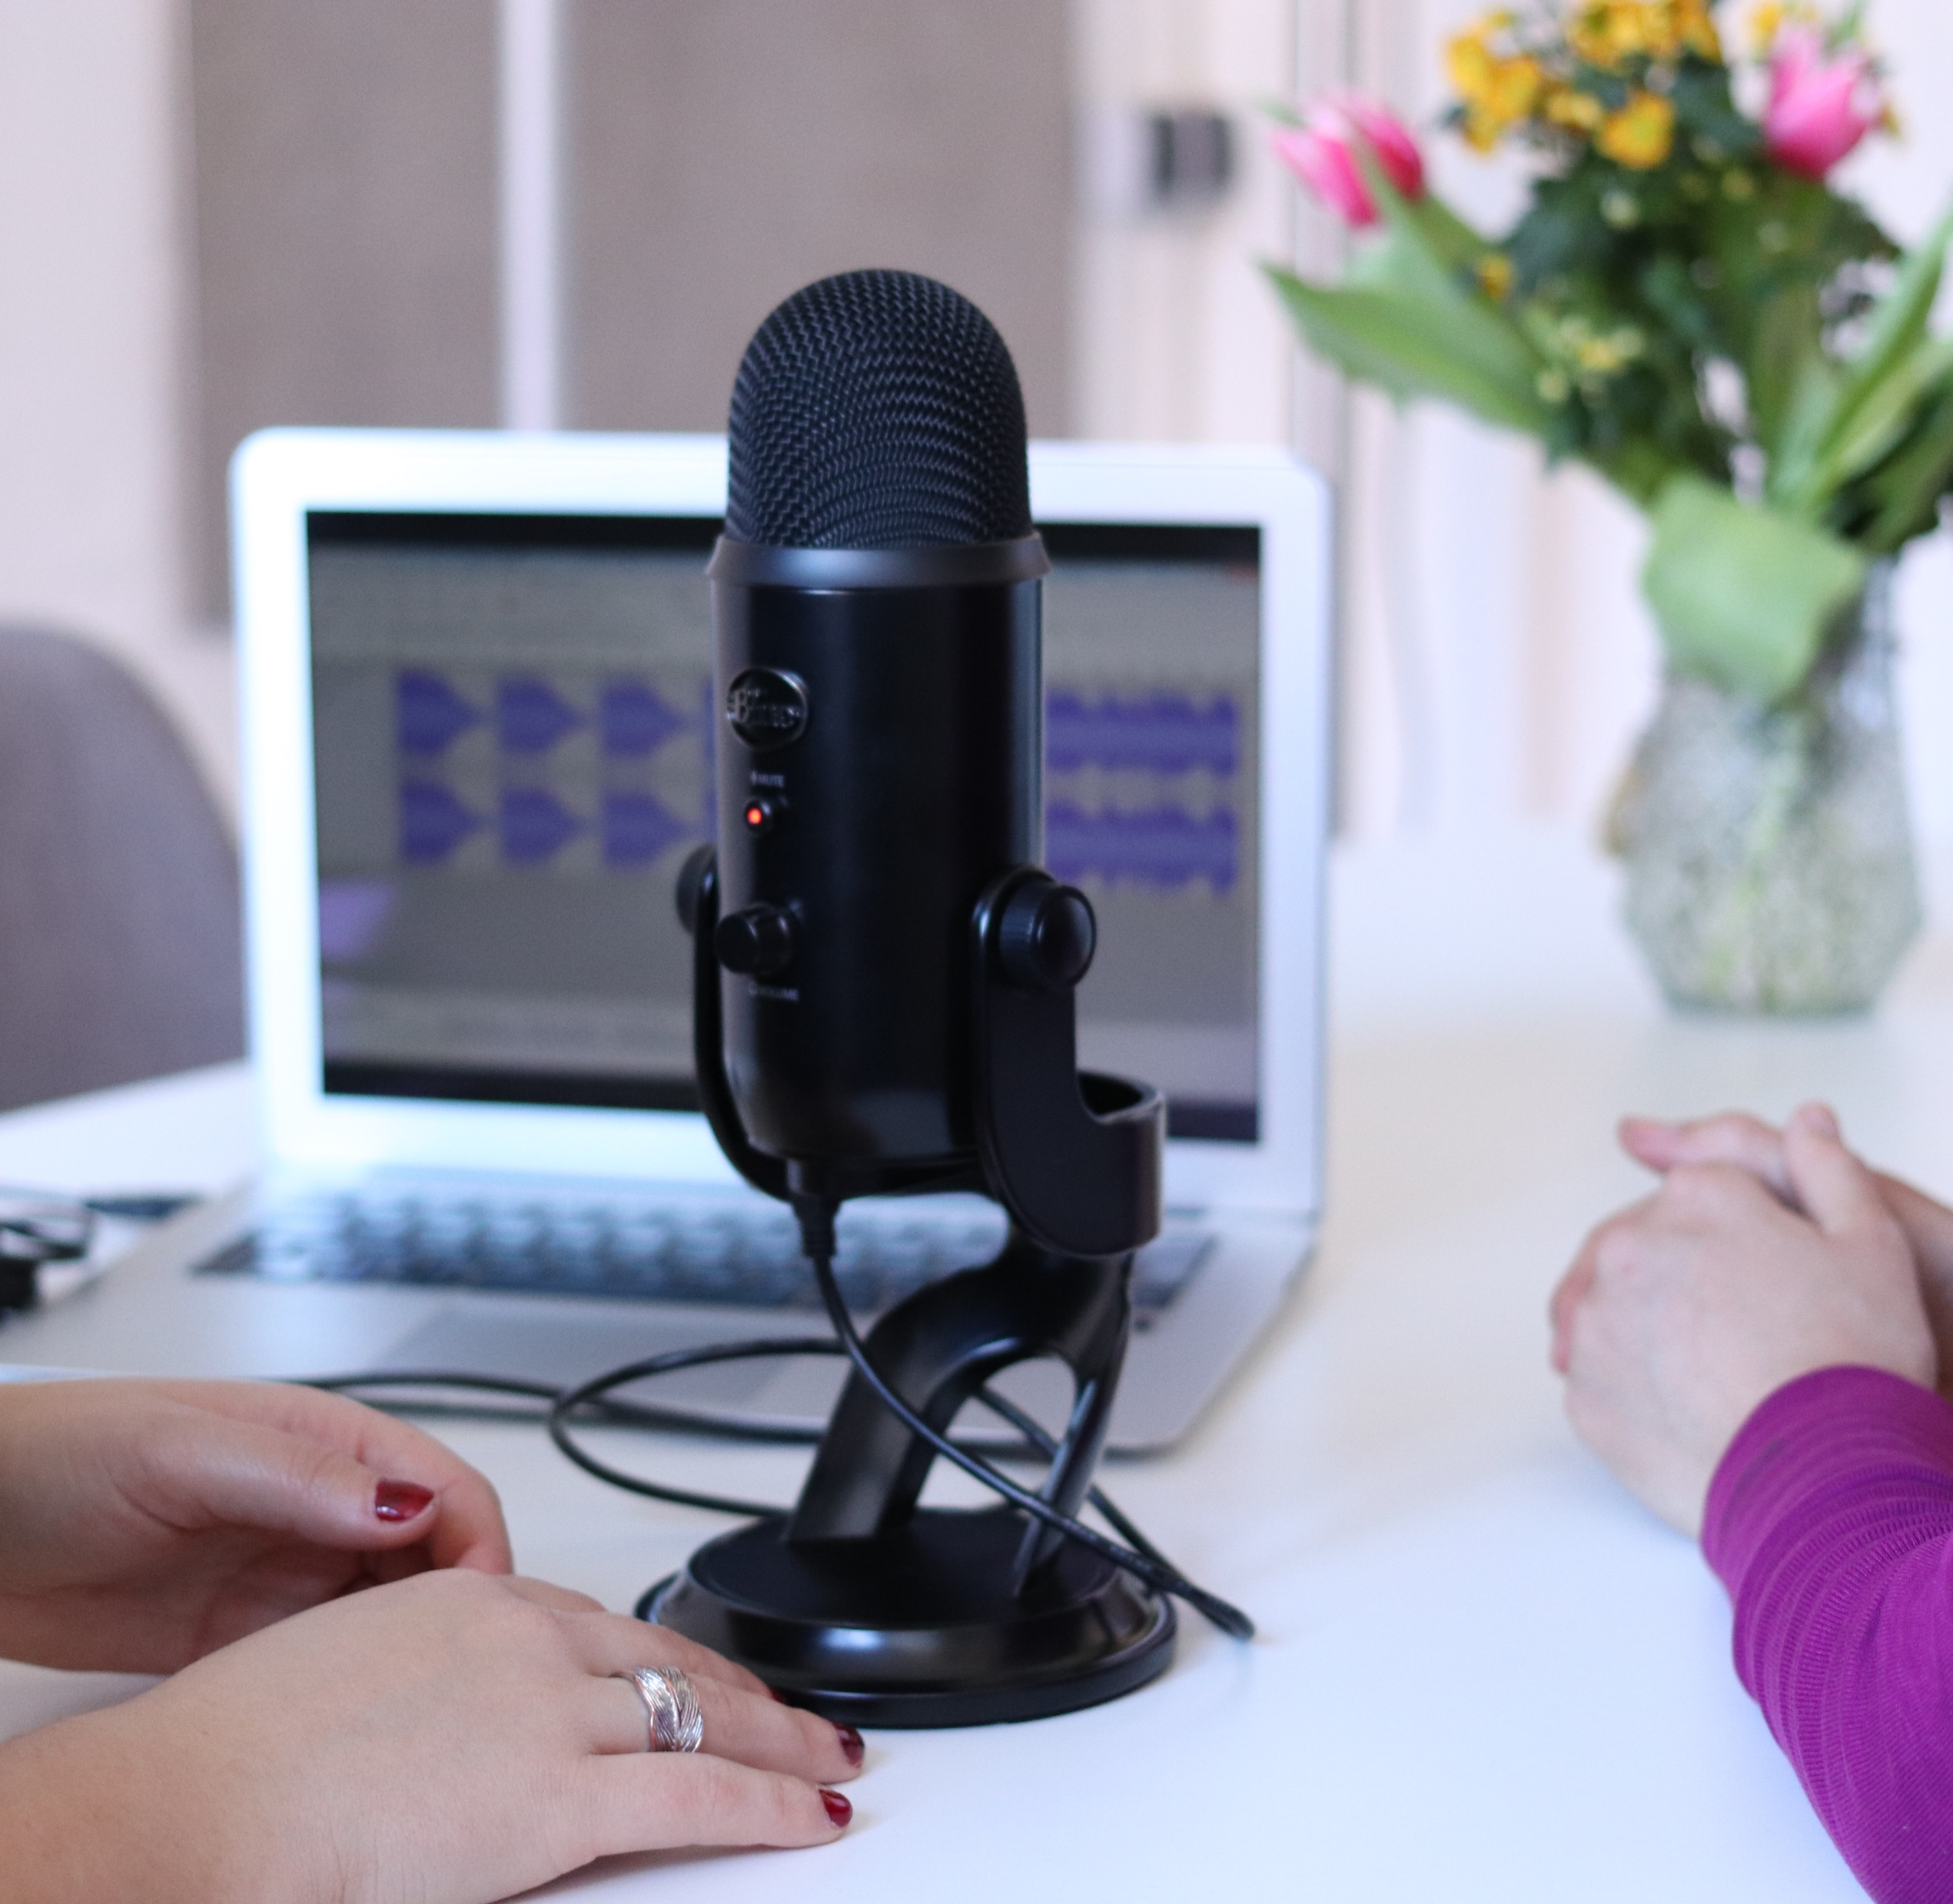

CSS 478: Usability and User Centered Design
Week 5 – Tuesday
Instructor: Annuska Zolyomi
Guest speaker: Ursula Wright
While we wait for class to begin, how are you feeling today? (Use Zoom annotation tools to mark your answer.)

Slide 2
Today’s agenda
Topic | Target duration (minutes) | Target end time
Welcome | 5 | 3:35
Guest speaker: Design Thinking and UCD | ~ 30 | 3:50
Case Study | ~ 20 | 4:25
Stretch break | 10 | 4:35
Breakout rooms for assignment: Design Thinking Case Study: Acting Class | 20 | 4:55
Debrief | ~ 10 | 5:05
Case Study: Imagined next steps | 10 | 5:15
Wrap up | 5 | 5:20

Slide 3

Completed Assignments
Field Research: Observing People (was due 10/23)

Slide 4
Ongoing Week 5 Assignments
Individual
Weekly reading reflections
Group
Group Persona Exercise (due Wed, 10/28)
Group Immersion Synthesis (due Sun, 11/1)

Slide 5
Launching Week 5 Assignments
Individual
Prep for Nano-Usability Study (due Fri, 10/30)
Design Thinking Case Study: Acting Class (Sun, 11/1)
Midpoint feedback about class (Sun, 11/1)
Group
Plan Micro-User Research Study (due Sun, 11/01)

Slide 6


Welcome guest speaker, Ursula Wright, PhD!
Notes:
Ursula Wright has over 20 years of experience in the research and design of physical and digital experiences. Dr. Wright holds a PhD in Industrial Engineering from the University of Cincinnati with expertise in Human Factors and Ergonomics. The influence of her research and design efforts spans across a variety of robotic, software, and mobile applications for companies like Microsoft, Intuit, Boeing, and General Motors. Dr. Wright is currently a Senior Design Research Lead in the software industry and facilitates courses and workshops on topics like Design Thinking, User Experience (UX) Research, and Evaluating Human-Robot Interactions.

Slide 7


Ursula!
Notes:
Ursula Wright has over 20 years of experience in the research and design of physical and digital experiences. Dr. Wright holds a PhD in Industrial Engineering from the University of Cincinnati with expertise in Human Factors and Ergonomics. The influence of her research and design efforts spans across a variety of robotic, software, and mobile applications for companies like Microsoft, Intuit, Boeing, and General Motors. Dr. Wright is currently a Senior Design Research Lead in the software industry and facilitates courses and workshops on topics like Design Thinking, User Experience (UX) Research, and Evaluating Human-Robot Interactions.

Slide 8
User-Centered Design Process for Group Project
Wallow in the domain to generate naïve questions and build empathy
Initial Technology Immersion
Competitive and Inspirational Analysis
Preliminary observations and assessment of existing product usage to uncover potential opportunities (e.g., ethnographic evaluation)
Define ad-hoc personas and user journey maps
Nano – Usability Testing (Week 5 - 6)
Micro – User Research Study (Week 5 - 6)
Refine personas and target scenarios (Storyboarding)
Explore potential solutions through design (Sketches, wireframes, prototypes)
Usability Testing (Week 8-9)
Develop design and research recommendations (Week 10)

Slide 9

Week 5 Assignments
Individual
Prep for Nano-Usability Study (due Fri, 10/30)
Design Thinking Case Study: Acting Class (Sun, 11/1)
Midpoint feedback about class (Sun, 11/1)
Weekly reading reflections
Group
Group Persona Exercise (due Wed, 10/28)
Group Immersion Synthesis (due Sun, 11/01)
Plan Micro-User Research Study (due Sun, 11/01)

